Slide 1
Preparing for an Interview with

Slide 2
The Plan
DAY 1: Speaking Professionally
DAY 2: Find & Explore a job
DAY 3: Mock Interview “Speed Dating”

Slide 3
DAY 1:
Speaking Professionally
I believe my strengths are…

Slide 4
How do you think someone should speak in an interview?

Slide 5
6 quick tips for speaking professionally

Slide 6
Know Your Audience
An interview is not the same as hanging out with friends at someone’s home or at the park
Remove slang
Keep it clean
Hello, how are you today?

Slide 7
Smile
Go ahead and smile. It’s free!
Often makes other feel at ease
No need to smile the entire interview – just a few natural smiles throughout

Slide 8
Speak Slowly & Clearly
The best public speakers are those who are easily understood
Helps the listener understand what you are saying
No need to speak at a snail’s pace — just slow enough to allow clarity for your listener
I believe my strengths are…

Slide 9
Eliminate “filler” words
Filler words can gain you time but sound unprofessional
Examples: LIKE, UH, UM
It’s okay to pause instead to gather your thoughts
I believe that my UM strengths are that I’m LIKE an incredible listener…

Slide 10
Eliminate “filler” words
Filler words can gain you time but sound unprofessional
Examples: LIKE, UH, UM
It’s okay to pause instead to gather your thoughts
I believe that my UM strengths are that I’m LIKE an incredible listener…

Slide 11
Know your terms
Take time to learn a few of the basic terms of the industry you are trying to enter
Read through job descriptions…and learn a few industry terms that pertain to skills or experiences you have
Avoid terms you don’t know

Slide 12
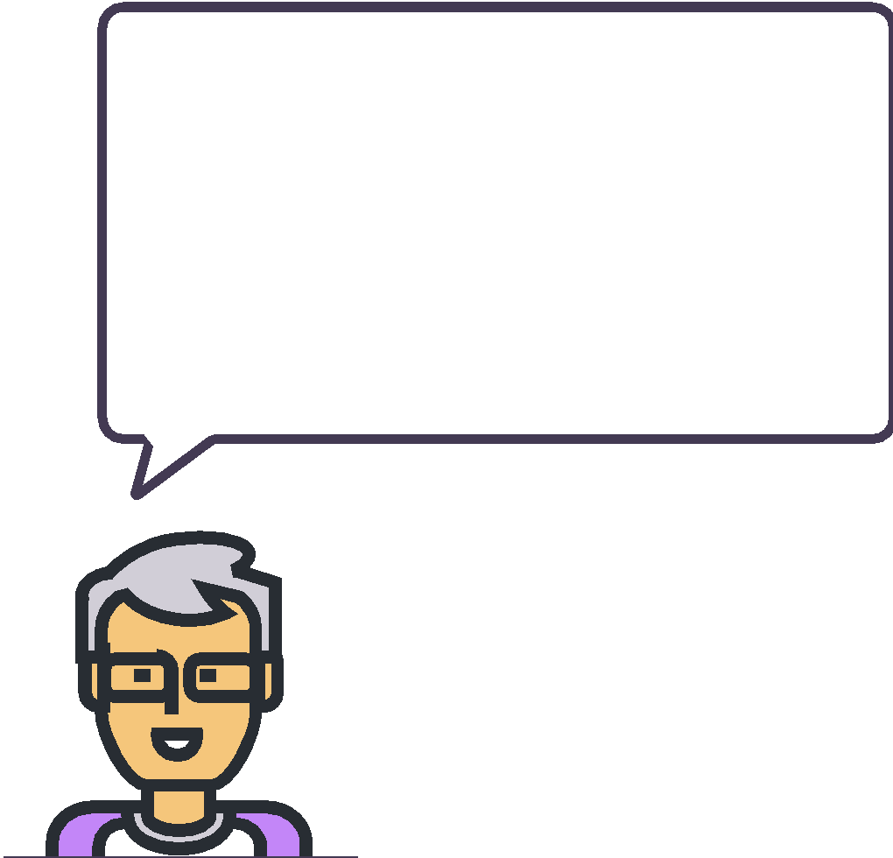
Know your terms
For example…
Job requirements
Demonstrate interest in and enthusiasm for learning about science, teaching science to diverse audiences, and conducting science
When volunteering at my church, I teach a diverse audience of children ages 6-7 that come from a variety of economic, cultural and racial backgrounds.

Slide 13
Breathe!
If you prepare and practice for your interview—relax
Just share what you can bring to the employer using the tips provided today

Slide 14
Practice
How could you reword the following when speaking in a professional setting like an interview or at work?
I totes fit all the requirements for this job.
So, what kind of money do I make in an hour?
You were cool to let me interview today.

Slide 15
Job interview best practices
Go to Careervillage.org
Log In to your student account
Use Search to explore:
  Common interview questions
  Questions to ask an employer
  Interview tips
Take notes in Table A

Slide 16
Thank you!

