Slide 1

Getting started on CareerVillage.org

Slide 2
CareerVillage.org’s mission is to democratize access to college and career advice for underserved youth.

Slide 3


Young people are finishing their education unready for the jobs we need them to fill.
Students are unready – Millions of low-income youth have never had a conversation with an adult about careers before, have no clear career goals, and no career plans.
Traditional mentorship hasn’t scaled – Students face long waitlists to get a mentor.
K-12 can’t solve the problem – There are 500 students for every HS counselor in America.
Students turn to Google to learn about careers

Slide 4
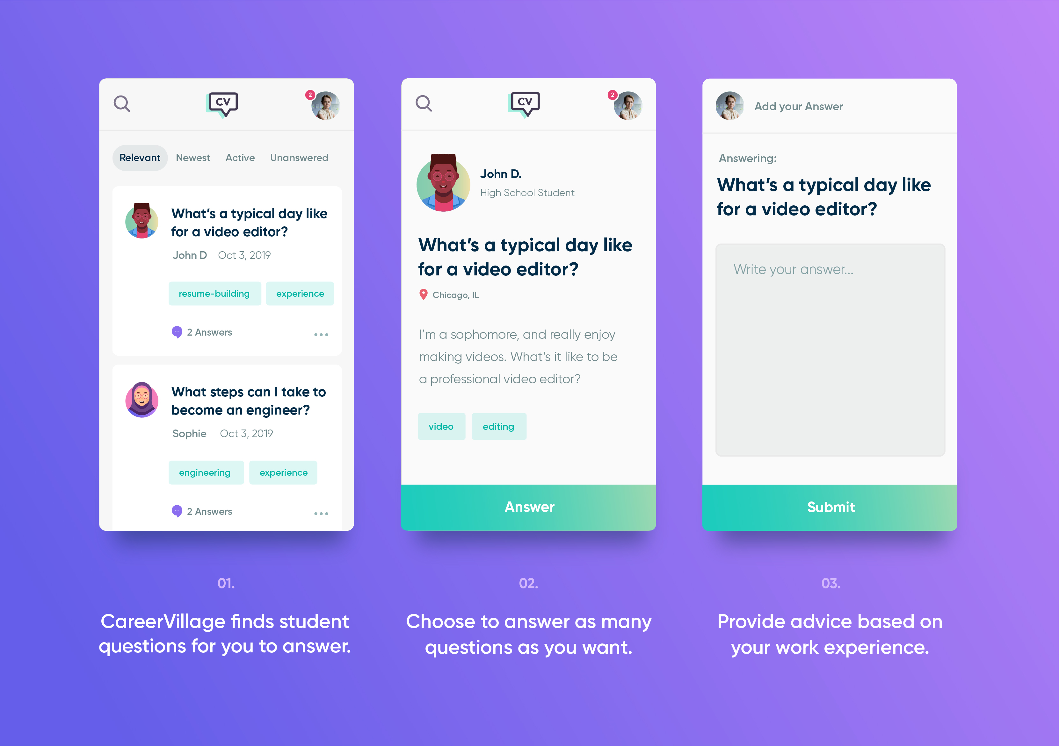
Our solution
Crowdsourced career advice
Questions from real students
Answers from real professionals
100% free for all
Indexed and searchable
Open access (This is a public site, so all information posted can be seen and shared with anyone within the CareerVillage.org community.)

Slide 6

CareerVillage.org helps reverse this ratio.

Slide 7
Impact
40K
8K
4M+
Registered volunteers giving advice
Career topic tags covered by questions
Unique online learners served
Middle school ~20%
High school ~50%
College ~30%
+ 50% underserved students (online & ed outreach)
+ 50% female
1/3 are corporate partner volunteers!

Slide 8

190 out of 195
Countries most active on CareerVillage.org
Countries on Earth where online
learners used CareerVillage.org
to get career advice in 2018
USA
India
Canada
Philippines
United Kingdom
Australia

Slide 9
Appendix:
STUDENT onboarding presentation

Slide 10
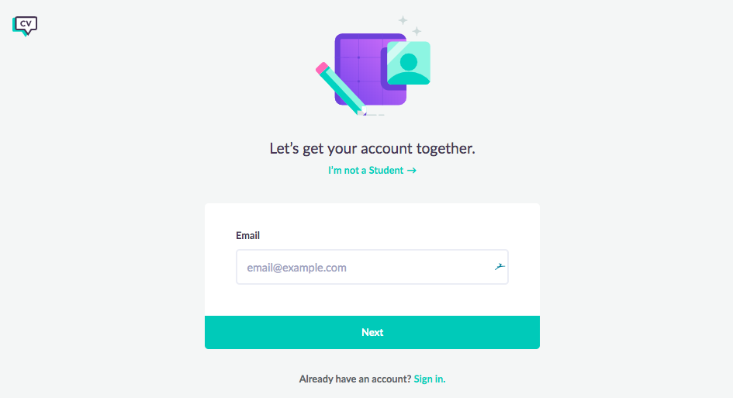
1. VERY IMPORTANT: Sign up via your unique classroom URL OR class code

Slide 11
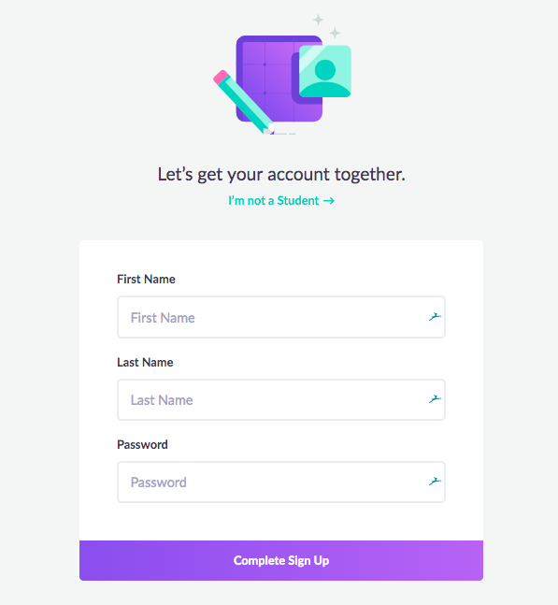
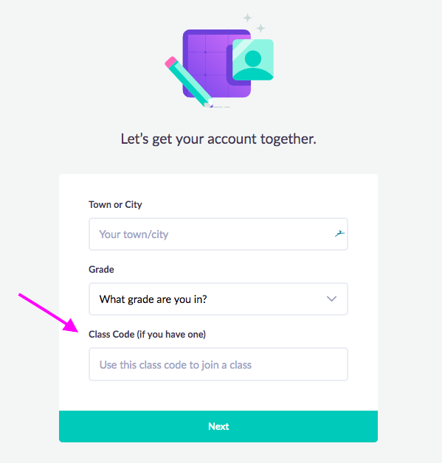
Fill in the requested info

Slide 12
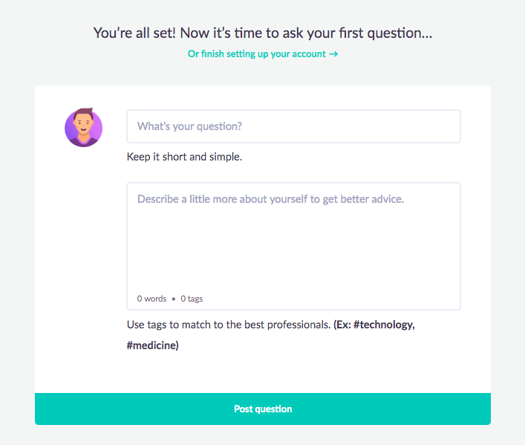
2. Take action! Ask your first question.

Slide 13
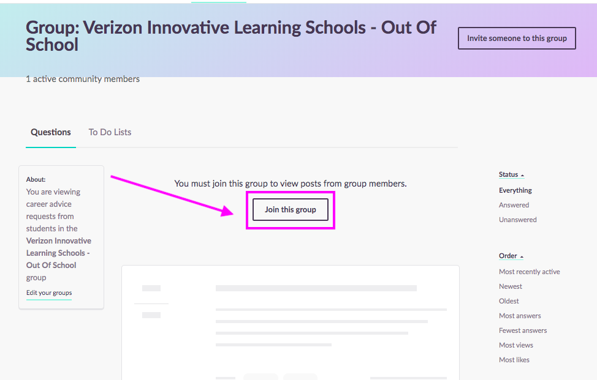
3. Join your group by going to:
{INSERT GROUP URL}

Slide 14


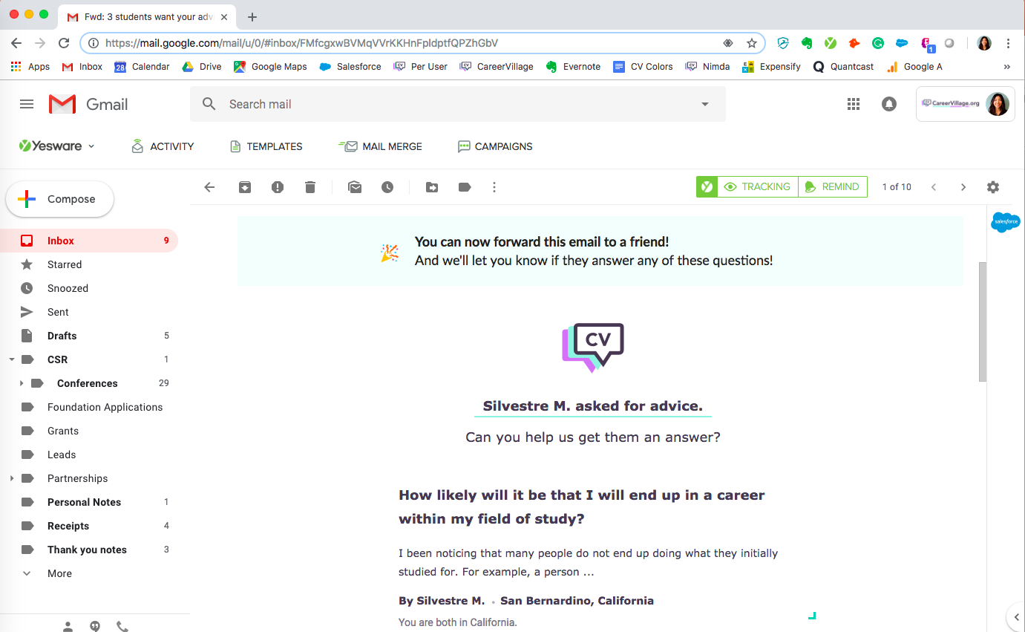
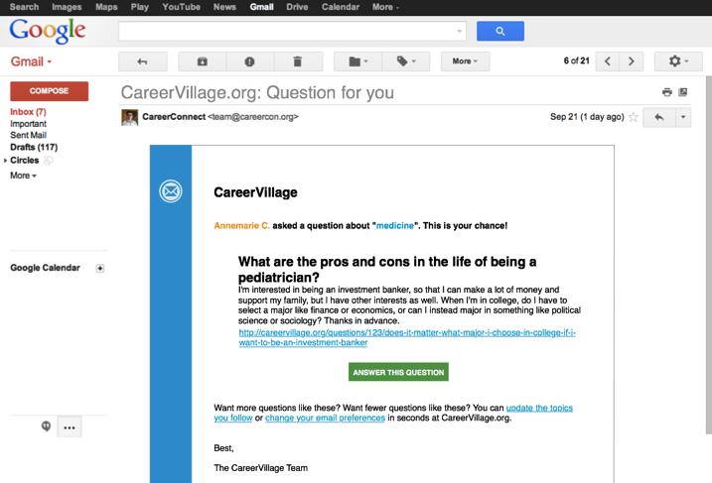
CareerVillage will send your career question to its Professionals!

Slide 15
Two tips:
🙏 Say thank you!
Someone took time out of their day to write you career advice. Be sure to thank them in the comment section of the advice! It’s a great habit that will go a long way in your professional and personal life.
• ? Have a follow-up question? Ask!
You can use the comment section under the advice or post a new question!

