Slide 1
The website that gets your questions about college and careers answered online by actual working professionals.
Notes:
CareerVillage is an online platform where you can ask any college and career related questions you have to actual professionals who have relevant experience.
You will get personalized advice and guidance that will enable and empower you to become better prepared for your future.

Slide 2
Who are our professionals?
Notes:
CareerVillage has over 10,000 registered professionals giving personalized career advice from hundreds of amazing companies, organizations, and institutions
Our professionals hail from all backgrounds and cover career fields spanning from Accounting to Zoology

Slide 3
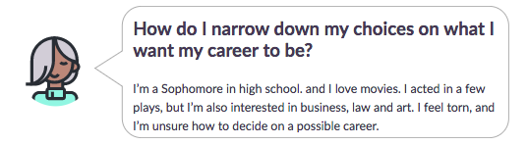

How Q&A Works on CareerVillage
Students post a college or
career related question
Working professionals
answer that question
CareerVillage notifies students when their question is answered
Notified through Email and your CareerVillage profile
Notes:
Students ask any college or career question on CareerVillage.org from a computer or mobile device (Make sure to include context of WHY you have that question, 3-5 sentences)
CareerVillage sends that question out to our volunteer professionals with the experience and backgrounds to best answer that question
Once a volunteer answers a question, that student is alerted on their profile and with an email that their question has been answered
Students learn from the professional advice and leave a comment with a thank you note or a follow up question to that volunteer

Slide 4
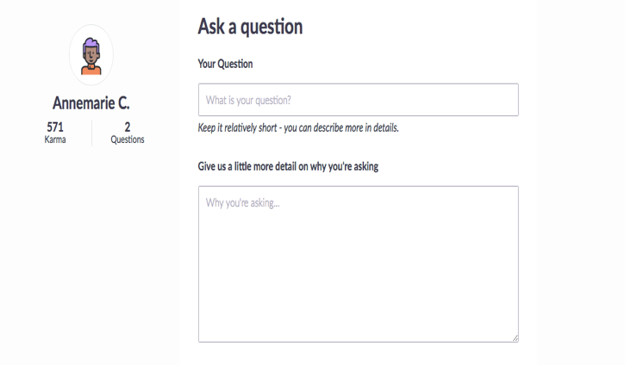
Your question’s detail matters!
Details you can provide to improve your question
Why are you interested in learning about this topic?
Your grade level
Your skills and interests that relate
What will you do with your answer to this question?
A personal story that led to this question

Slide 5
#HASHTAGS
Remember to add multiple hashtags in your Question’s Detail box.
Hashtags are categories and topics that help describe your question and career you are asking about.
On your profile, you can add the #hashtags you are most interested in seeing questions and advice from

Slide 6
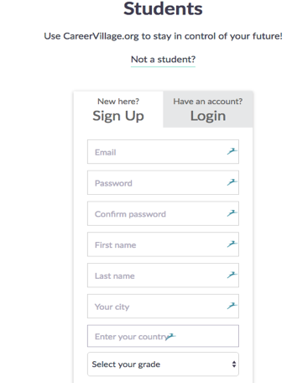


Time To Get Started! – Create a student account and ask a question today!
Sign up as a ‘Student’ on www.CareerVillage.org
Make sure to enter your ‘Invite Code’
Browse CareerVillage for existing advice
Ask your own college or career related question!

Slide 7
